Slide 1
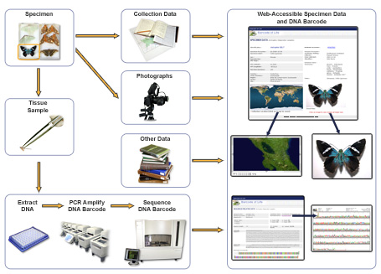
DNA Barcoding
From ibol.org/about/dna-barcoding/

